Slide 1

Professional Diploma
Adult Social Care
Launch 2024
Notes:
Introduce Nicholas: Nicholas Starkey, OIPC London Principal. Fundamental in the set up of this new exciting program

Slide 2




CHARLIE VINE
OIEG
New Product Launch Director
AARON GIBBONS
OIEG
Director of Global Admissions
Nicholas Starkey
OIEG
London Centre Principal
LANI WHITE
OIEG
Senior Marketing Manager
Notes:
Introduce Nicholas: Nicholas Starkey, our London Centre Principal. Fundamental in the set up of this new exciting program

Slide 3

Professional Diploma – Adult Social Care
The Professional Diploma in Adult Care is accredited by City and Guilds and provides international students with a clear progression path to gain employment in the UK in a care setting.
QUICK FACTS
Intakes:
July | September | November | January | March | May 25’
Duration of study
7- 9 months
Level of study
Level 3
English Language
5.5 IELTS score with no component less than 5.5
Minimum Age
Students must be 16 or over to enrol
Tuition Fee:
£14,995 (£3,000 deposit)
Notes:
6 intakes a year, First intake= July 2024 onwards.
The programme is intended for those who have a strong interest in working within the care sector. It offers a clear path to employment within a short period of 9 months.
The programme is a 3-term model, powered by the digital institute and the 3rd term will offer a work placement.
Tuition fee = £14, 995
The average salary after completion is £23,730.

Slide 4
Pathway VS Careers
Both studied at the existing London and Oxford Centres with all students enjoying the same support and international community
1. OIPC Pathway- route to University
Students undertake Level 3 foundation at either London OR Oxford
On successful completion of program Progress to 17 University's across the UK, including:
- Reading University
- Oxford Brookes
- Bristol University
- University of Hertfordshire
- Falmouth University
2. OIPC Careers (NEW)- Vocational program direct to INDUSTRY
Students undertake a short 7–9 month program including placement in either London or Oxford (depending on program location).
OIEG supports applicants' employability
Successfully gain employment in care industry
Average starting Salary c£24,000

Slide 5






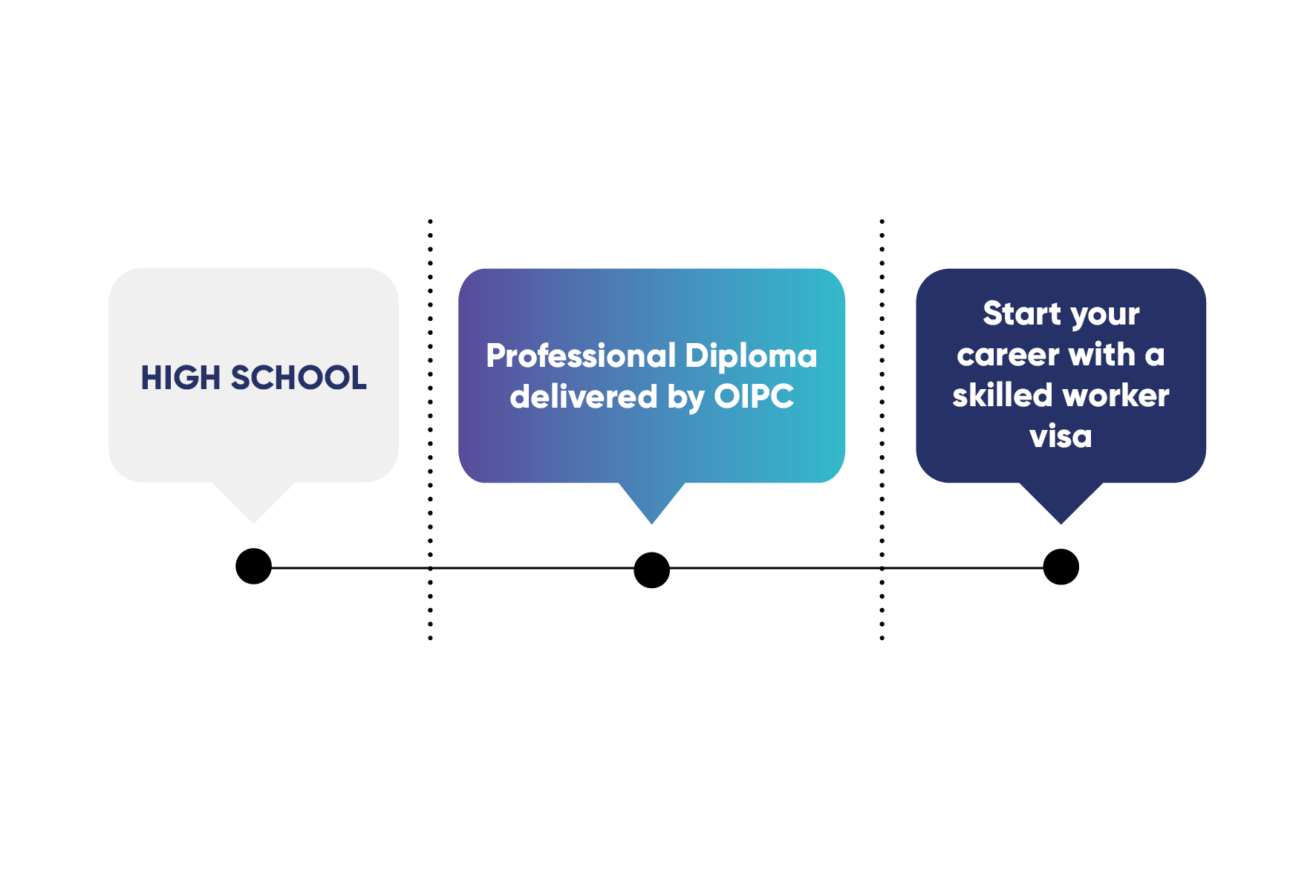
What is the Professional Diploma in Adult Social Care?
Clear path to gain employment in the UK in a care setting.
Expert instruction providing students with in-depth knowledge of all aspects of care work in the UK.
Focused language skills
to allow them to carry out their role with confidence.
Gain real-world experience through a work placement while studying, allowing students to develop the skills needed to succeed.
Support to progress into employment with confidence in the care industry upon graduation.
After successful graduation and on receipt of a job offer you will be eligible to apply for a UK Skilled Worker Visa.
Notes:
Nicholas

Slide 6
How is the course delivered?
The course is delivered in-person, with online support powered by the OI Digital Institute learning platform.
Students will complete 3 terms over 9 months, preparing them to start their career on graduation.
Students complete an online e-portfolio and their progress is closely monitored via their Virtual Learning Environment, allowing OIEG to provide further support where needed.
Term 1
Term 2
Term 3
13 weeks of tuition delivered face-to-face at one of our UK colleges.
Students will complete:
Mandatory and optional units covering 15 Skills for Care Standards
First Aid Qualification
Moving and Handling Certificate
Language skills
9 weeks of instruction delivered face-to-face at one of our UK colleges.
Students will complete:
All knowledge-based requirements
Workplace induction
12-week work placement at an organised care provider
3 weeks of instruction delivered face-to-face back at London or Oxford OIEG centre.
Students will complete:
Refine language and employability skills ready for the workplace.
Notes:
Nicholas

Slide 7
Modules you will study
Core modules you will study:
Safeguarding and protection in care settings
Responsibilities of a care worker
Promote personal development in care settings
Promote health, safety and well-being in care settings
Promote communication in care settings
Promote effective handling of information in care settings
Duty of care in care settings
Promote equality and inclusion in care settings
Promote person-centred care
Elective modules to enhance your learning:
Undertake agreed pressure area care
Move and position individuals in accordance with their care plan
Work with individuals who have specific communication needs
Understand person-centred thinking and planning
Supporting infection prevention and control in adult care
Knowledge, skills and behaviour expected of a lead adult care worker
Support Individuals to eat and drink
Support individuals to meet personal care needs
Provide support to manage pain and discomfort
Support use of medication in adult care
Understand the process and experience of dementia
Understanding advocacy
Understand the context of supporting individuals with learning disabilities
You will study these modules during terms one and two with your arranged work placement during term three.
Notes:
Nicholas

Slide 8




How is the course assessed?
Initial Assessment
Portfolio of Evidence
All students will be given an initial assessment at the start of the course to identify:
Specific training and language needs
Additional support and guidance
Any units already completed, or credit which is relevant to the qualifications
Any additional optional units you wish to take
All students will also complete a portfolio of evidence covering the assessment criteria for each unit.
The majority of the assessment will be through Direct Observation (70%) of your performance by a qualified occupationally competent assessor.
Other assessment methods may include:
Professional Discussion (7.5%)
Reflective Accounts (7.5%)
Projects / Assignments (7.5%)
Case Studies (7.5%)
Notes:
Nicholas

Slide 9

Your placement
So you can gain real-world experience to help you start with confidence after graduation, we arrange a 1 term work placement during your study.
A work placement will mean working full time in a care home based near your place of study. It will require an induction from the care home and then carrying out all the duties required of a Care Assistant.
The care home will supply a Job Description which will outline the role and responsibilities and support the student by giving opportunities for them to be assessed carrying out workplace tasks.
Notes:
Nicholas

Slide 10

Your career after study
There are thousands of job opportunities in the UK care sector. With this qualification, you can progress into roles such as:
Lead Adult Care Worker
Lead Personal Assistant
Key Worker
Domiciliary Care Worker
Senior Care Assistant
Support Worker
The average salary for a Senior Carer is £23,730 per year*
*Glassdoor.co.uk
Guaranteed employment upon successful graduation
Notes:
Nicholas

Slide 11
Our Guarantee
Question: What happens if a student does not secure employment after the programme with OIEG?
Answer: Oxford International will provide a full refund of their Level 3 tuition fees if all the below listed conditions have been met and verified by OIEG and their Level 3 Programme Supervisor:
Maintained the required attendance during the 9-month OIEG program, including placement and
Received passing grades in all areas of the OIEG programme (written and practical)
Received satisfactory reports from the placement provider
Respectfully and professionally worked with male and female senior residents from varied ethnic backgrounds
Attended and positively participated in the job and interview skills classes
Have attended at least 3 interviews with a potential employer in addition to their work placement provider
Have demonstrated a strong desire to attain the position
Have successfully passed the programme approval board and achieved full Level 3 award from accreditation partner (within 1 year of course start date)
Notes:
Charlie

Slide 12

Skilled Worker Visa
Health and Care Worker Visa
Our Professional Diploma in Adult Social Care is accredited by City and Guilds. Completing the diploma and the 12-week placement gives you an advantage over other candidates and helps you secure a job offer from a UK employer.
The job offer will allow students to apply for UK skilled worker visa (Health and Care Worker Visa).
We will also support students to sign up with an employment agency in the UK.
Notes:
Charlie

Slide 13

Your career after study
1
GRADUATION
Successful graduation - completion of all modules and placement.
2
SECURE JOB
Secure a job in the UK at a recognized health and care business.
3
APPLY FOR VISA
Apply for your Health and Care Worker Visa to enable you to start your new career in the UK.
4
RESIDENCY
Live and work in the UK in an in-demand profession. Your working visa is valid for 5 years whilst you are in employment with the same employer.
BEYOND
Once you have resided in the UK for 5 years you are then eligible to apply for Indefinite Leave to Remain (ILR) and continue your growing career in Health and Care.
Oxford International are not visa/immigration consultants and it is advised you check gov.uk website for the latest information and updates about worker visa and citizenship applications.
Notes:
Charlie

Slide 14


Why study through
OIPC Careers
Our OIPC Careers centres offer a professional diploma which supports you to
start work
upon successful graduation and gain a ‘Health and Care Worker’ Visa.
Employability
support
International
community
. . .
. . .
Focused content
Individual support
. . .
. . .
Notes:
Charlie

Slide 15





The London Centre is located in Greenwich and linked to the University of Greenwich.
During your studies, you will receive the academic, social and professional support to start your care journey in the UK and work towards your future success.
Key Facts
Wi-Fi and computer access
Self-study room and academic support
Social space
Library

Slide 16






Meet the team at the London Centre
Nic Starkey
College Director
Elaine Kniveton
Academic Director
Eabha McCarthy
Student Support Manager
Anne Marie Munro
Head of Quality Assurance
Jill Akerman
Trainer & Assessor
Sarah Jacques
Assessor
How we support our students:
Access to
Additional course
Exercises 24/7
Student Career
support
Academic
support
Supervised
Study sessions
Social
programme

Slide 17






Enjoy a show at one of the 39 theatres in the West End.
LIVELY
LONDON
Over 300 languages are spoken in London
Taste homemade treats and shop the pop-up stalls at the Greenwich Market
Relax in one of London’s eight Royal Parks
Endless areas
to explore
from Camden Town, to Notting Hill and Canary Wharf
More than 170 museums and 22,000 music performances each year

Slide 18


c
Accommodation Options in London
London Centre students can choose their accommodation during their stay with us. We have different options including homestay and residence.
Homestay
Experience life in a British home.
Homestay provides students with a welcoming family
and a place to call home while pursuing their
education. You will have your own bedroom in a
house and share the social space and facilities with
the host family. The homestay will be located up to 30
minutes by public transport from campus.
From £230 per week
Vita Student Accommodation
Safe and secure student accommodation in
Lewisham, just a short distance from the London
centre, students can stay in luxury spacious
accommodation with a wide range of amenities.
There are Accessible, Classic and Classic plus rooms
available to choose from.
From £330 per week

Slide 19






Join the celebration of the traditional Oxford Mayday Festival
Punting on the River Cherwell or grabbing a coffee with friends
WONDERFUL OXFORD
Cheer the rowers in the annual Henley Royal Regatta at Henley-on-Thames
Extensive mountain bike trails and incredible scenery to explore
Famous Harry Potter film locations in Christ Church, Bodleian Library and New College
Fresh local farmers markets pop up in the town each week
Notes:
CLARE- until slide 20

Slide 20



Key Facts
OIPC Oxford.
Wi-Fi and computer access
Self-study room and academic support
Social space with table football
Library
Welcome Pack
All students at the Oxford Centre have a choice of one of the following offers for the duration of their studies:
Netflix Subscription
Immerse yourself in a world of endless entertainment.
Pure GYM Membership
Enjoy 24/7 access at any
Pure GYM location.

Slide 21

Get to know your campus
Located in the heart of the City of Oxford.
Oxford is packed with history and culture; a bustling cosmopolitan city, allowing you to truly immerse yourself and feel at home.

Slide 22



We provide safe, secure and welcoming accommodation that gives you the independence to explore. During your time with us, you can choose to stay with a host family or in one of our residences. Whichever option you choose, we will ensure your stay with us is safe, comfortable and fun.
Accommodation
In Oxford
Homestay
Our Homestay accommodation offers you the opportunity to live with friendly and welcoming hosts in their home.
From £225 per week
Student
Castle
Perfectly located in the heart of Oxford, the Student Castle residence is a newly built student residence with excellent facilities such as a fully equipped gym open 24/7 and private study spaces.
From £290 per week
The Mews
The Mews is a property comprising of single ensuite bedrooms in apartments of 4, 5 or 6 with a shared kitchen and dining area. Located in a quiet residential area but still only a short bus-ride from the school.
From £255 per week

Slide 23
Entry requirements
In order to begin your course, you will need to provide proof of your English language level.
English Language
Entry requirements
Professional Diploma Academic Requirements
5.5 IELTS score with no component less than 5.5
Contact your Regional manager who can let you know what other language tests we accept in your country.
Professional Diploma Academic Requirements
5 GCSE/IGCSE at grades A*-E or Two GCE A levels (grades E) or Three GCE AS levels (grades D-E)
Please visit oxfordinternational.com for country equivalencies

Slide 24

How to apply
TO COMPLETE YOUR ONLINE APPLICATION, WE WILL NEED THE FOLLOWING:
A copy of a valid passport
A copy of your original qualification certificate and transcripts | Certified translation
Any current and previous UK visas, CAS and copies of exit stamp. Please also include a copy of any previous visa refusal letters | If non-EU and previously studied in the UK
Valid proof of English level | Students will need to take a UKVI approved Secure English Language Test (SELT).

Slide 25
Entry & Progression admissions support / process
1
2
3
4
5
Make online Application
Receive Offer and CAS letters
Start your student visa application
Pre-Arrival support
Study at London or Oxford
Start your
new career
in the UK!
We will review your application and inform you/ your agent of your eligibility.
Receive your offer to study at.
Students with OIEG. Applicants will be required to sit a suitability interview. On successful completion you will receive a
CAS letter for your Visa application.
Once you have received your CAS letter you are able to submit your visa application.
Pre-arrival: Meet the student support team who will provide any help prior to arriving.
Course starts along with tutorials to make sure everyone is on track.
Congratulations! You can now start your new career and apply for your UK Health and Care Worker Visa

Slide 26




Why study OIPC Careers
Guaranteed employment upon successful graduation
£23,730 PY average salary for a Senior Carer
Option of either London or Oxford for program and placements
Short programme to employment - 7- 9 months
Highly competitive tuition as low as £8,000 for entire program (Net)
Notes:
Before we go onto Q&A
NEXT STEPS:
Launch event planning: Based off initial forecasts presented by your RDs/ AD’s and Country managers, we will review activities
Market specific materials requests
1. Non- South Aisa, First intake= July 2024 onwards.
2. South Aisa (minus India), First intake= September 2024 onwards

Slide 27
Marketing Support Materials
We are updating all out existing materials to include Adult Social Care as well as creating some new materials to support you and your students.
We have as part of this the following:
Factsheet – Professional Diploma - Adult Social Care
Factsheet - Diploma - Adult Social Care (Level 2 online)
Pull-up banners
Presentation deck
Updated Brochure (available in May)
Notes:
Before we go onto Q&A
NEXT STEPS:
Launch event planning: Based off initial forecasts presented by your RDs/ AD’s and Country managers, we will review activities
Market specific materials requests
1. Non- South Aisa, First intake= July 2024 onwards.
2. South Aisa (minus India), First intake= September 2024 onwards

Slide 28
Q&A

Slide 29
Frequently asked questions:
QU: Is there a maximum age limit?
ANS: There is no maximum age limit imposed however assessments will be made on a case-by-case basis. The applicant should acknowledge that they will need to be able to fulfil physically demanding tasks such as lifting. We are open to interviewing those of all ages.
QU: For applicants who are 16/17 years of age, do they need a guardian?
ANS: Official process on this to be circulated shortly
QU: Are we accepting IELTS equivalents such as PTE?
ANS: Yes, we are accepting SELT proficiency tests for this course, please refer to the OIEG website for further information on the requirements.
QU: Are payment instalment plans available?
ANS: Payment instalment plans are not currently available; however, this is open to change in the future and is being reviewed depending on the demand for it.
QU: What is the deposit fee?
ANS: £3,000
QU: Is accommodation available?
ANS: Accommodation is not reserved for those undertaking the course; however, they will find plenty of available accommodation in the surrounding area. The centre teams will be happy to assist students to find appropriate accommodation as needed.

Slide 30
Frequently asked questions:
QU: Can they apply if the already have a bachelor’s degree from their home country?
ANS: Yes, they can. However, they should be aware that suitability will be assessed on a case-by case basis. Those who have an academic background or work history in the care sector are preferred.
QU: Are student visas going to be an issue?
ANS: No, as long as they meet the requirements.
QU: Can this programme be used as a foundation course to nursing?
ANS: This course is intended mainly for students who want to go directly into care related employment.
QU: Where will the work placement take place, and will students be required to travel?
ANS: We will always aim to place students within close proximity to the centre or their accommodation, so students will not be required to travel lengthy distances to complete the work placement.
QU: Are scholarships available?
ANS: Yes, scholarships are available! For the OIPC Careers at our Oxford Centre, we are offering scholarships of up to £6,995, which can lower the tuition fee to £8,000. For the London centre, we’re offering scholarships of up to £5,995, which can lower the tuition fee to £9,000.

